Slide 1
Present Quiz
Team Number 4
Members: Chris Cox & Charles Ritchie

Slide 2
Application Goals
Provide a replacement for iClicker
Free
Easy to use
Saves locally
Prevent students from skipping class

Slide 3
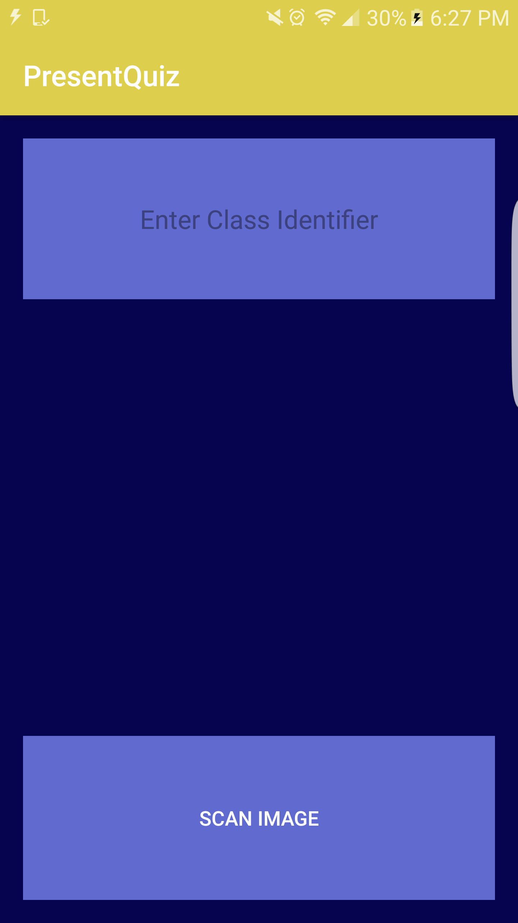
Target Users
College Students
Professors

Slide 4
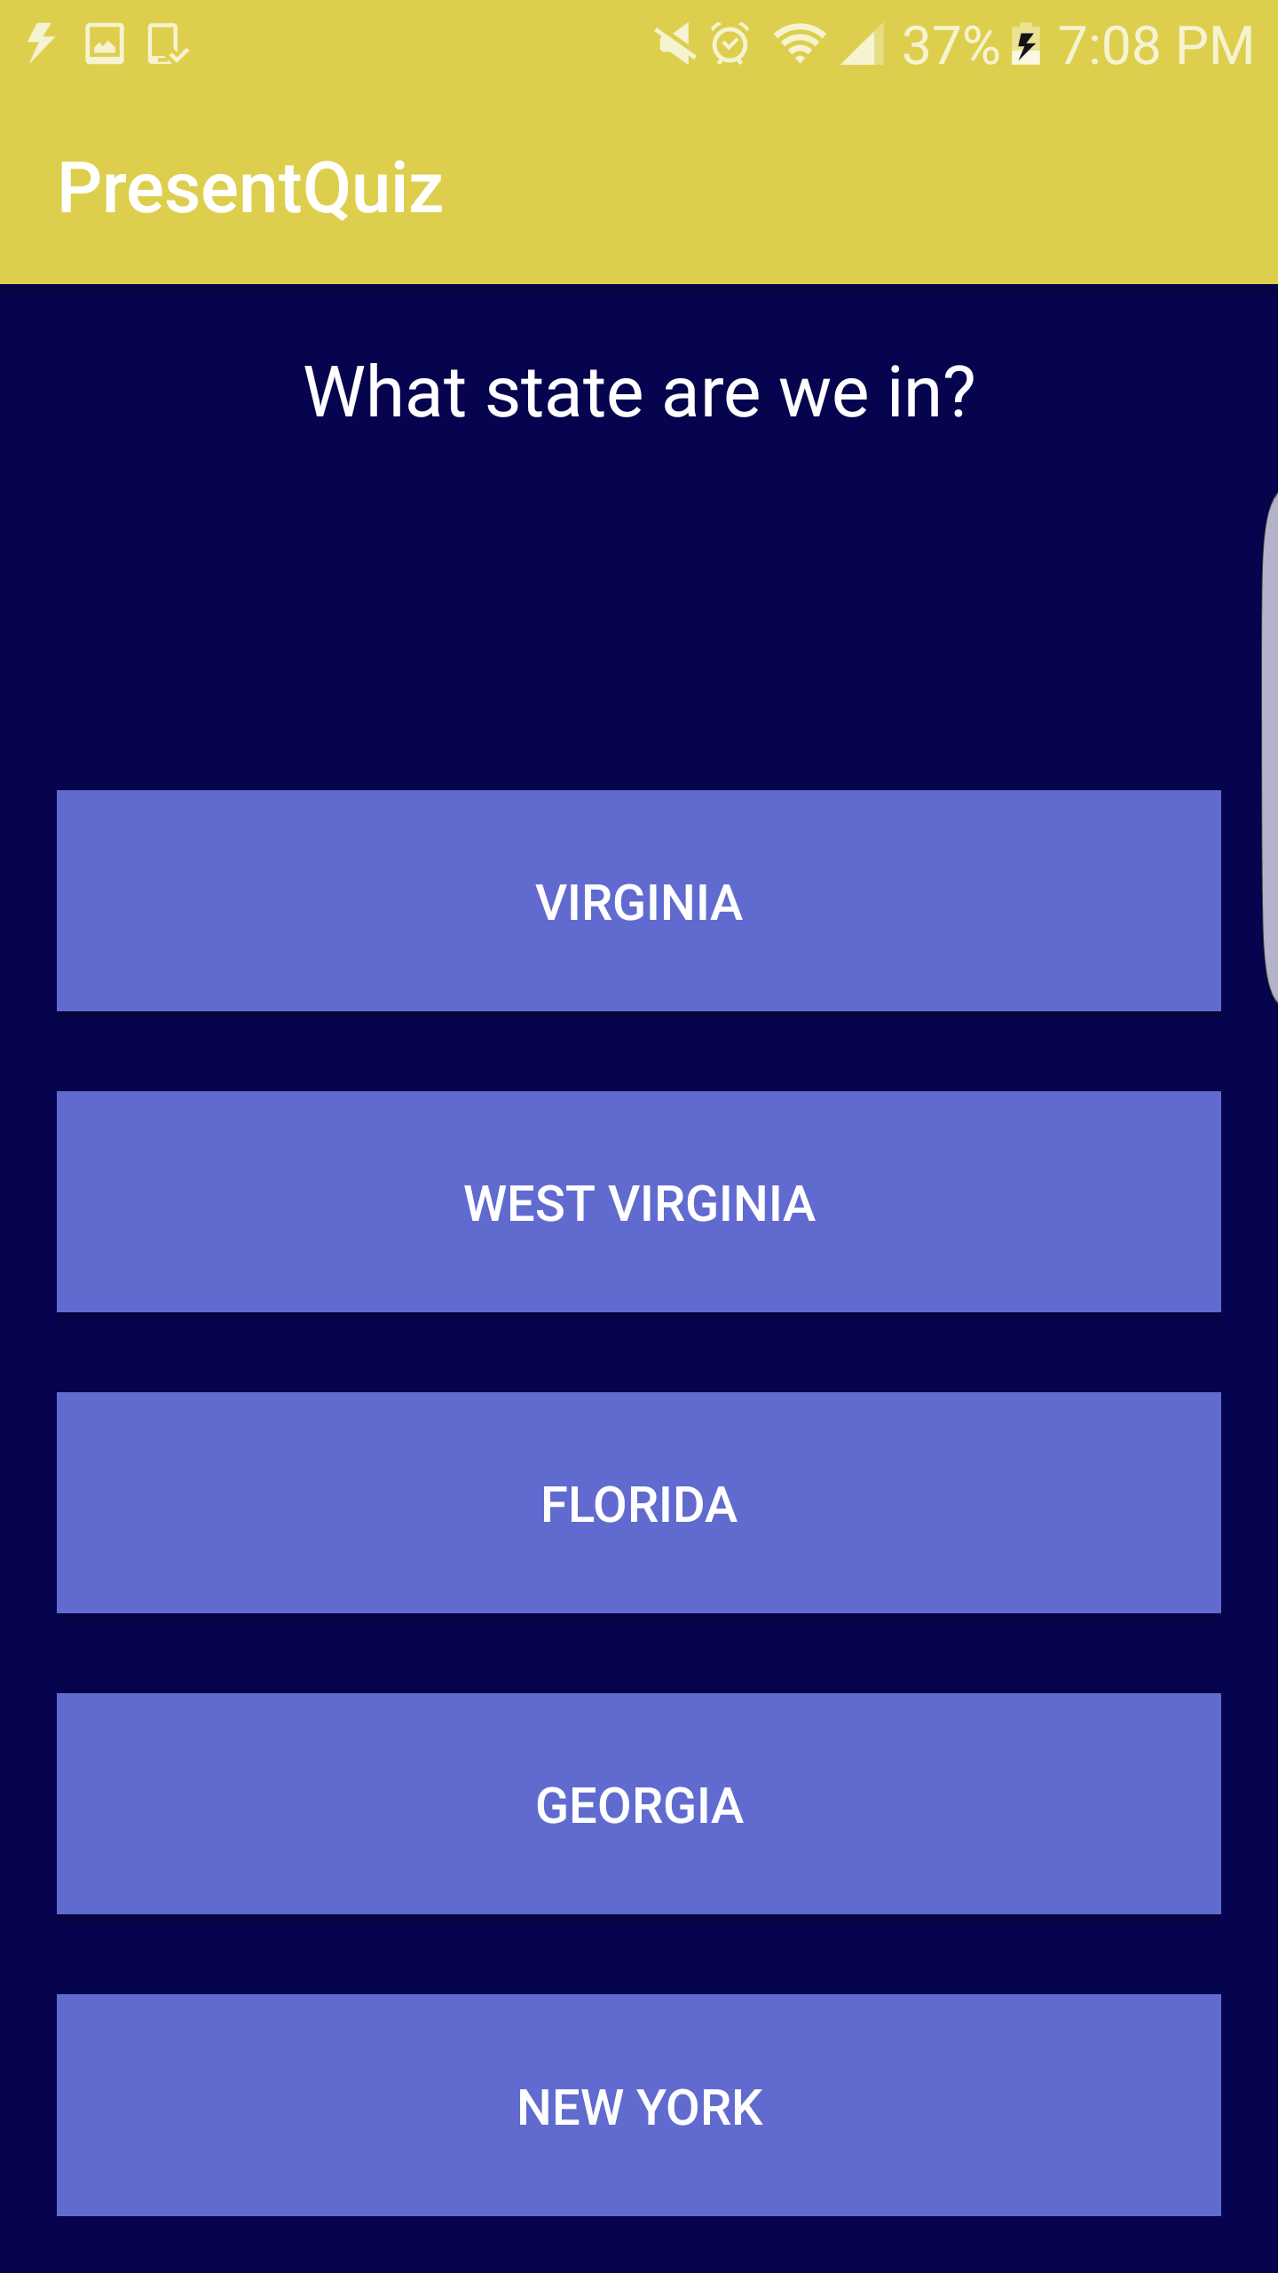
Main Application Functions
Multiple quiz question types
Short Answer
Multiple Choice
Immediate grade feedback for multiple choice questions
Easily accessible for the professor to view quiz submissions
FREE for the students!

Slide 5
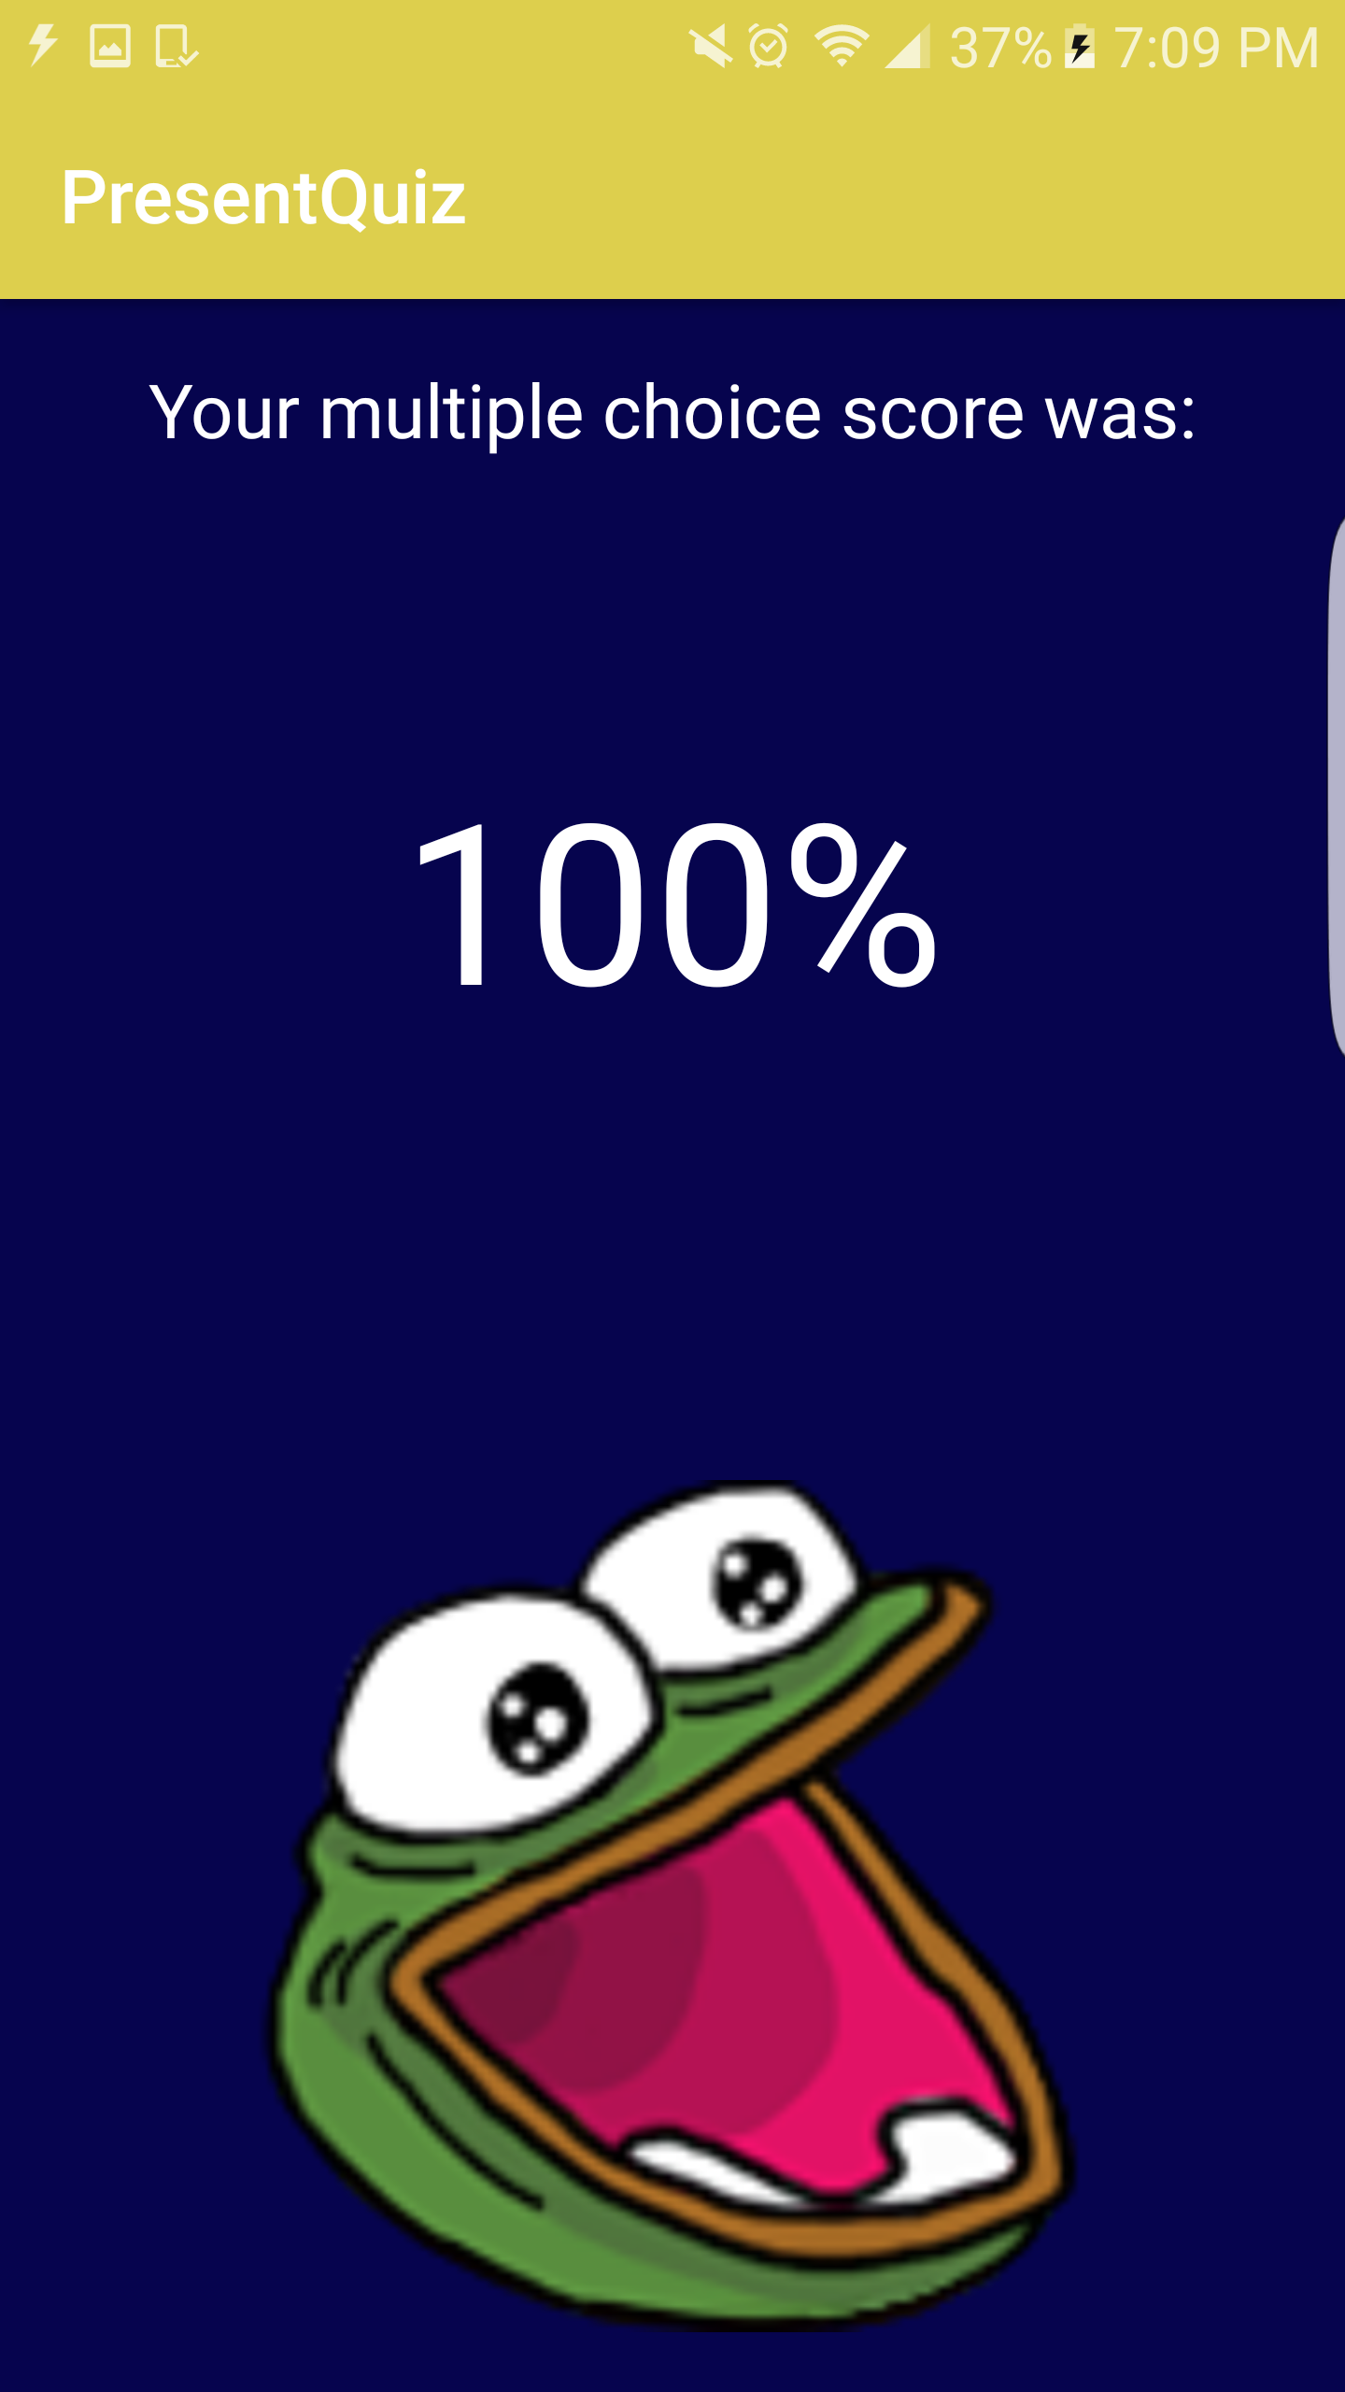
Unique Features
Complete server/client communication
Saves quiz results locally/immediately for the professor
(No downloading files)
Unique QR code scanner implemented
Unlimited number of editable questions for the professor

Slide 6
Future Improvements
Auto-generate QR code for server
On spot grading for short answer questions
Auto-upload grading to canvas
Eliminate professors work

